Slide 1
METABOLIC RESET: SINERGIA TRA TERAPIA NUTRIZIONALE E GLP1-RA
Prof. Luigi SCHIAVO
Professore Associato di Nutrizione Umana e Dietetica Applicata
Dipartimento di Medicina, Chirurgia e Odontoiatria
Università degli Studi di Salerno
Co-Coordinatore Nazionale Comitato Scientifico SICOB

Slide 2
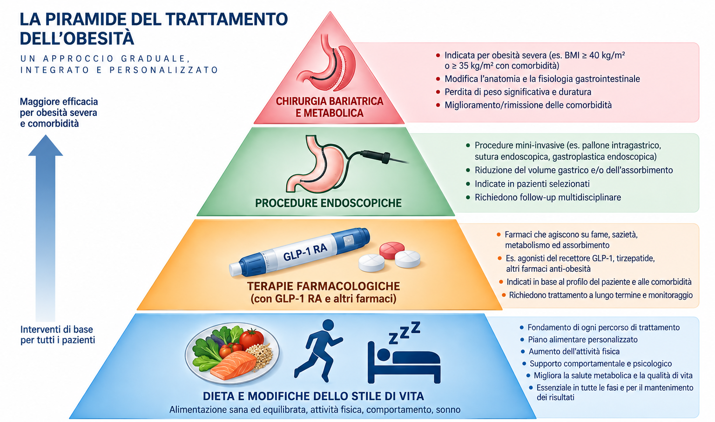

Slide 3
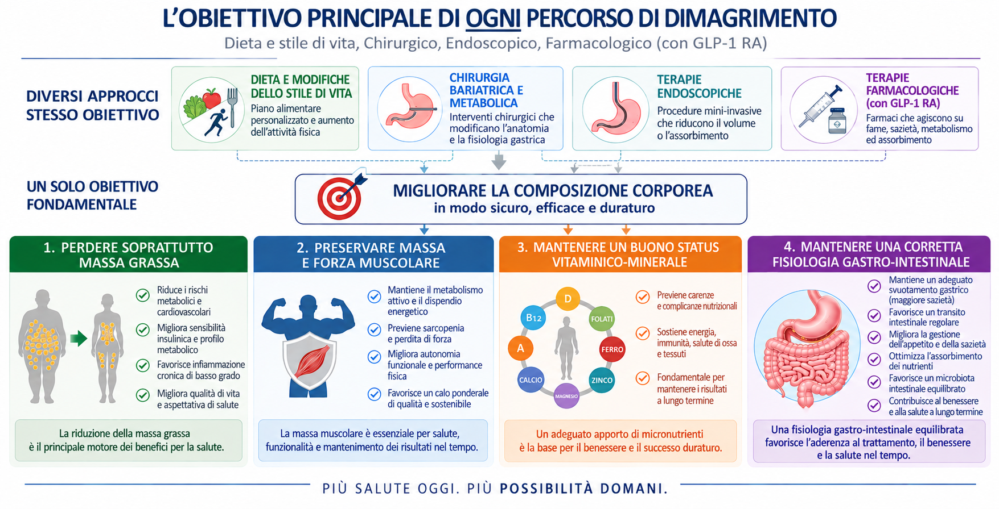
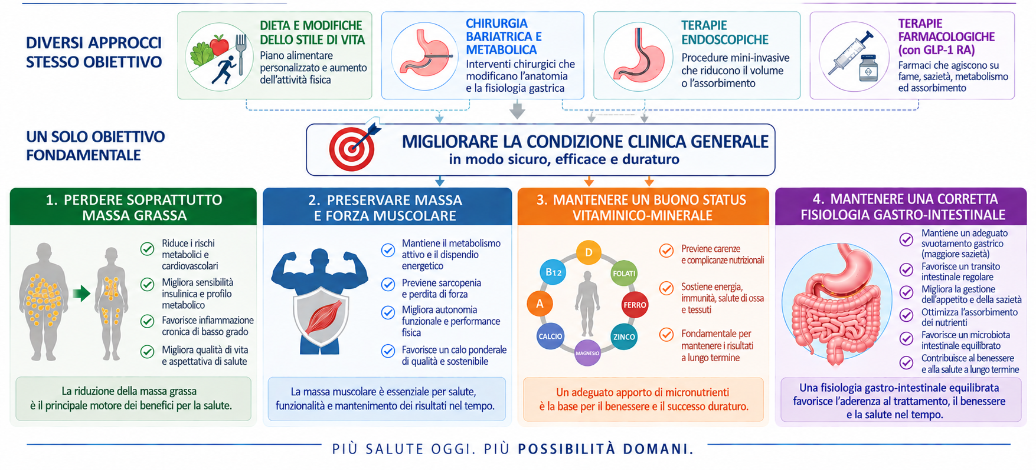

Slide 4
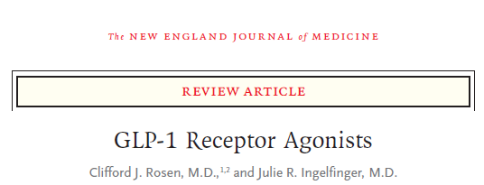

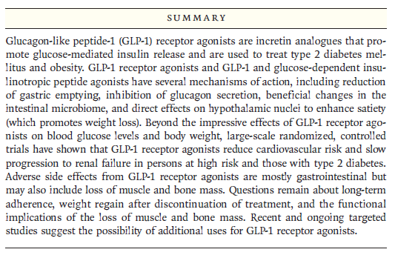
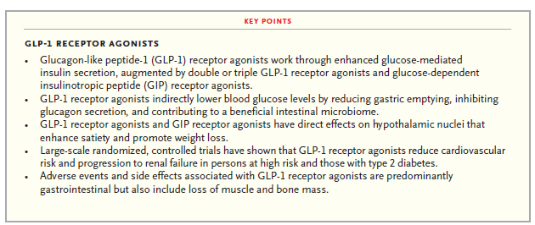
2026;394:1313-24.
DOI: 10.1056/NEJMra2500106
WEIGHT LOSS MAIN OBJECTIVE
TITOLO SLIDE

Slide 5
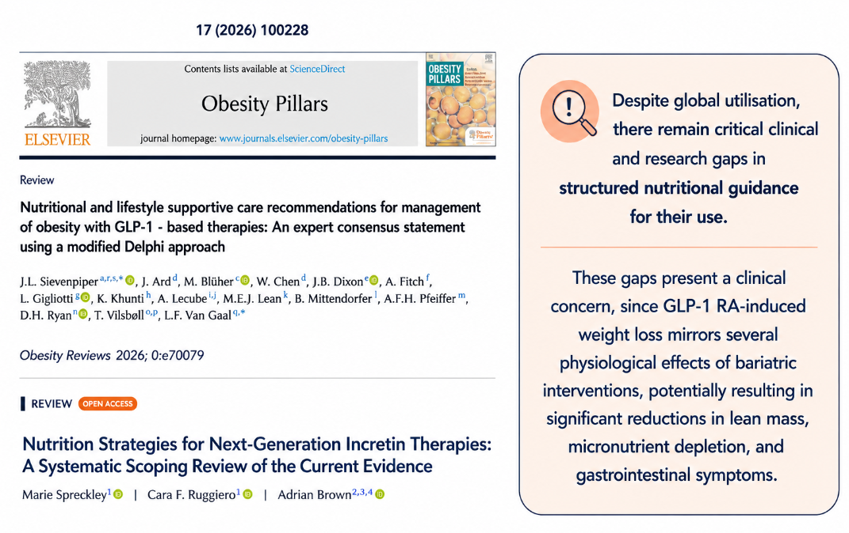

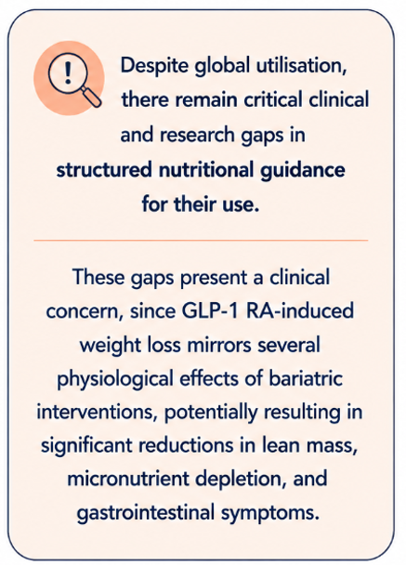
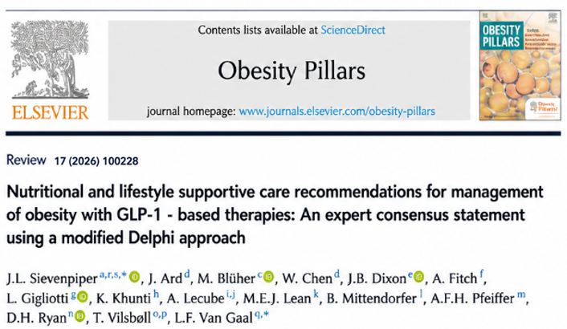

Slide 6
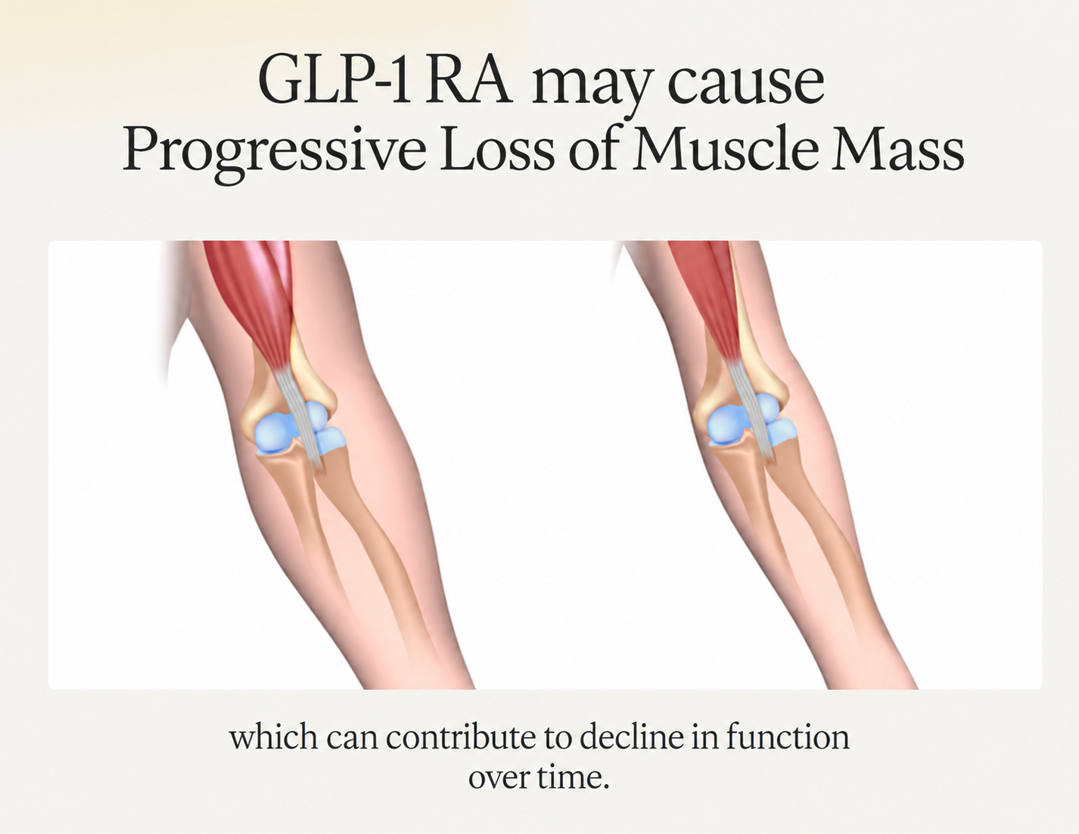

Slide 7
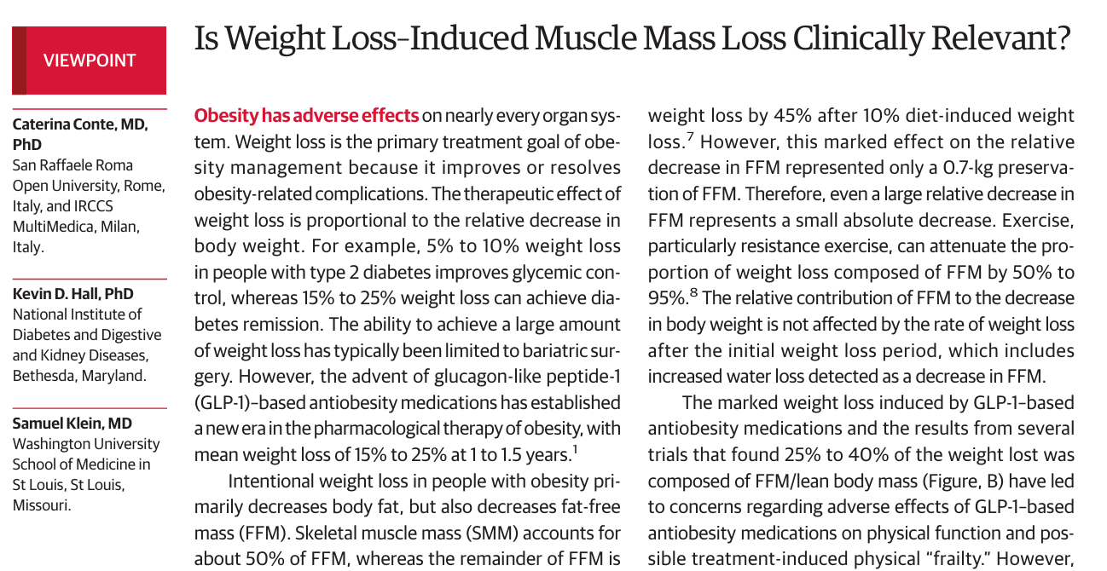
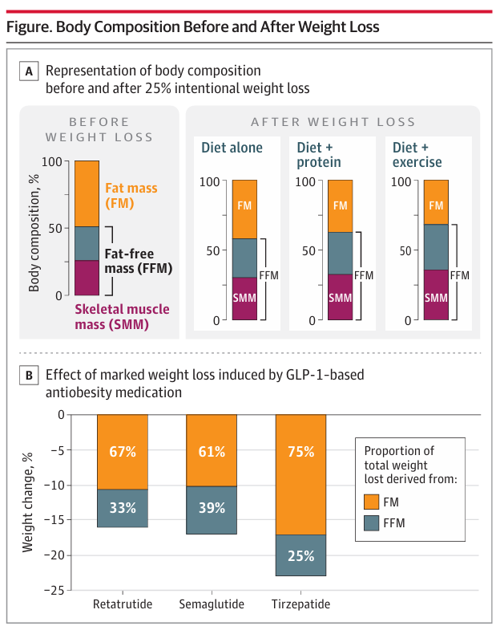
WEIGHT LOSS MAIN OBJECTIVE
TITOLO SLIDE
JAMA July 2, 2024 Volume 332, Number1
Several trials found 25% to 40% of the weight lost was composed of FFM have led to concerns regarding adverse effects of GLP-1–based anti-obesity medications on body composition changes
1:3

Slide 8
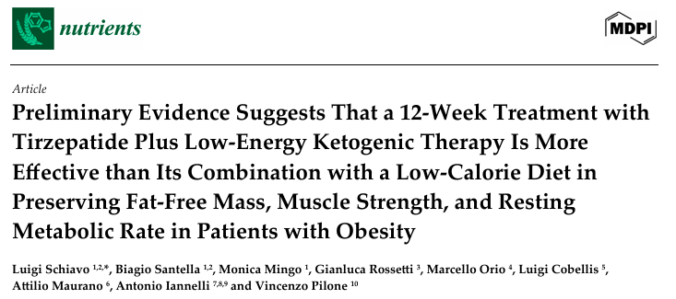
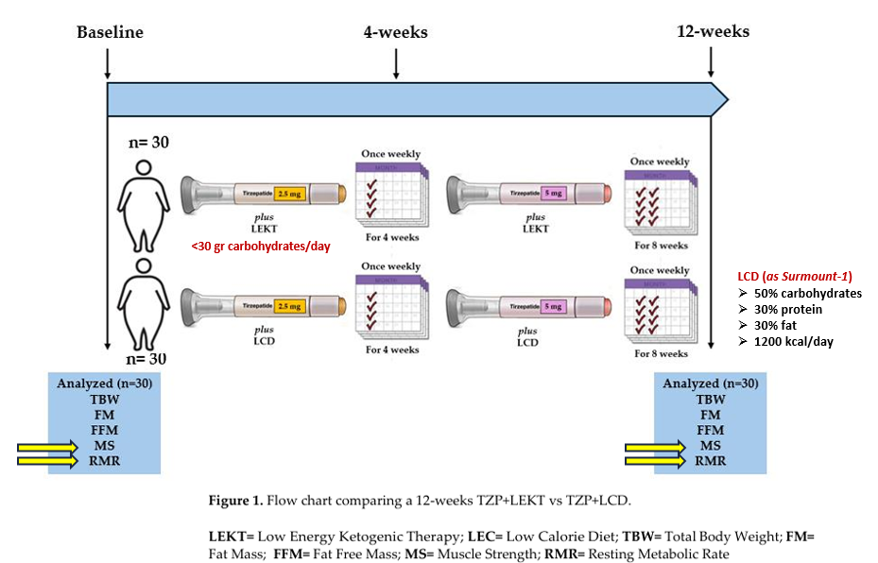
2025, 17, 1216
SURMOUNT 1 STUDY

Slide 9
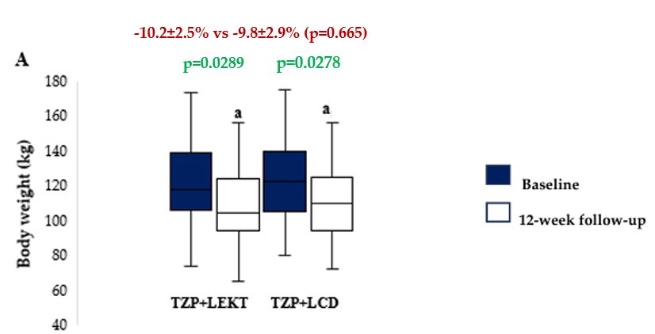
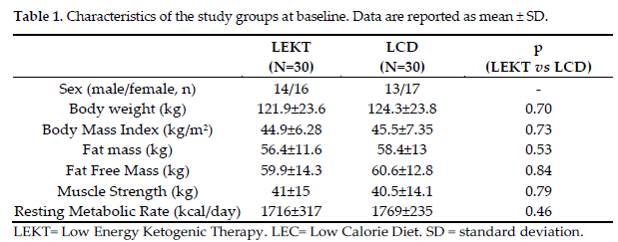
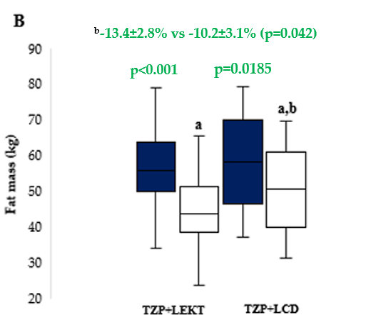
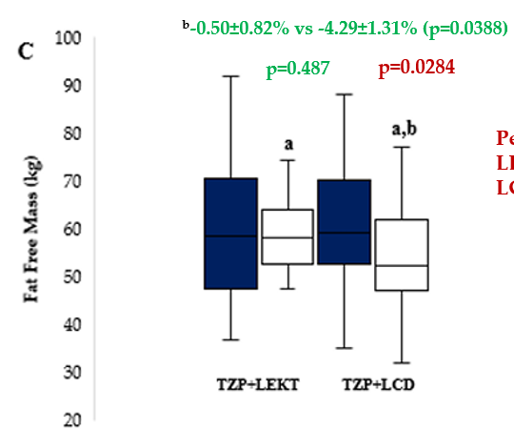
SURMOUNT 1 STUDY
RESULTS
Figure 2. Box plots showing baseline and 12-week follow-up changes in body weight (A), fat mass (B), and fat free mass (C) in both groups study. The horizontal bars represent the median values. Lower and upper boundaries of the box represent the first and the third quartile, respectively. Lower and upper error bars represent the minimum and the maximum value, respectively.
ª12-week follow-up vs baseline
^{b}12-week follow-up TZP+LEKT vs LCD

Slide 10
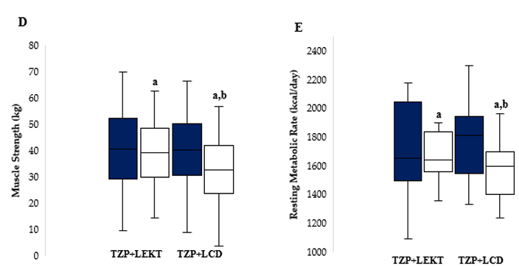
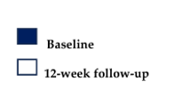
SURMOUNT 1 STUDY
RESULTS
^{b}-0.3±0.9% vs -4.1±1.2% (p=0.046)
^{b}-1.2±0.9% vs -5.3±1.8% (p=0.019)
p=0.691
p=0.0341
p<0.001
p=0.263
Figure 2. Box plots showing baseline and 12-week follow-up changes in muscle strength (D) and resting metabolic rate (E) in both groups study. The horizontal bars represent the median values. Lower and upper boundaries of the box represent the first and the third quartile, respectively. Lower and upper error bars represent the minimum and the maximum value, respectively.
ª12-week follow-up vs baseline
^{b}12-week follow-up TZP+LEKT vs LCD

Slide 11
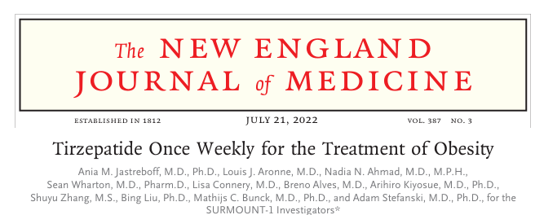
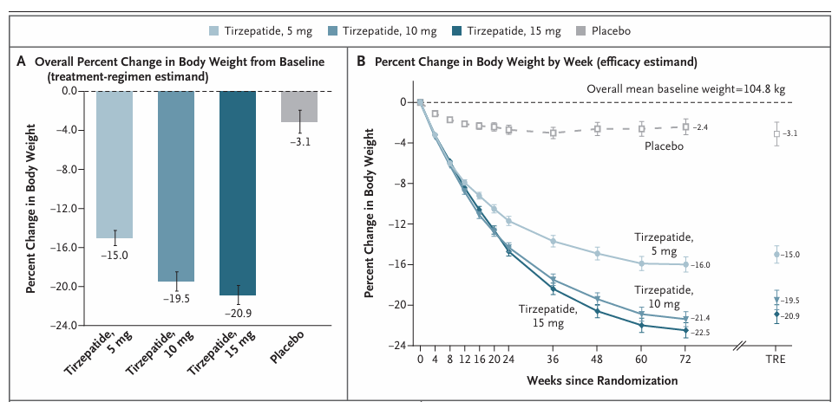
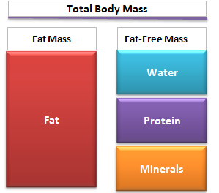
SURMOUNT 1 STUDY ANALYSIS AT 12 WEEK
SURMOUNT 1 STUDY
LCD = - 500 calories per day
72w
72w
33.9%
10.9%
12w
12w
8.5%
vs
13.4%
our study (LEKT)
1.9%
vs
0.5%
our study (LEKT)

Slide 12
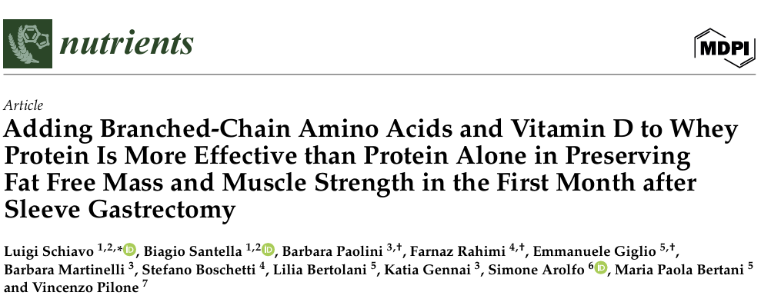
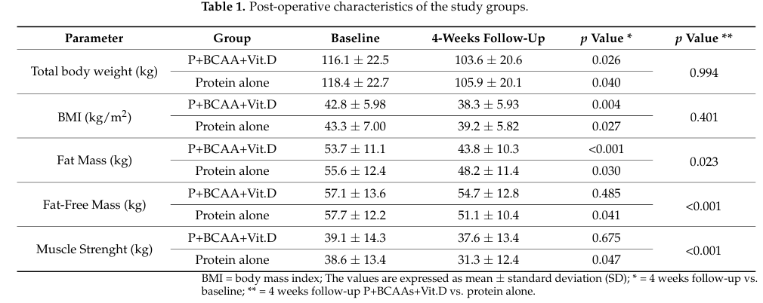
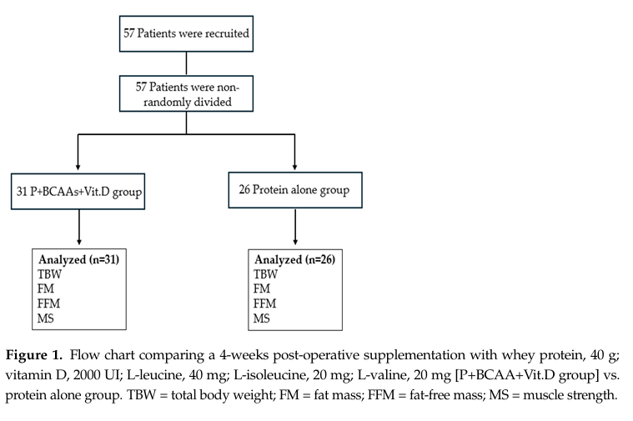
2024 May 11;16(10):1448

Slide 13
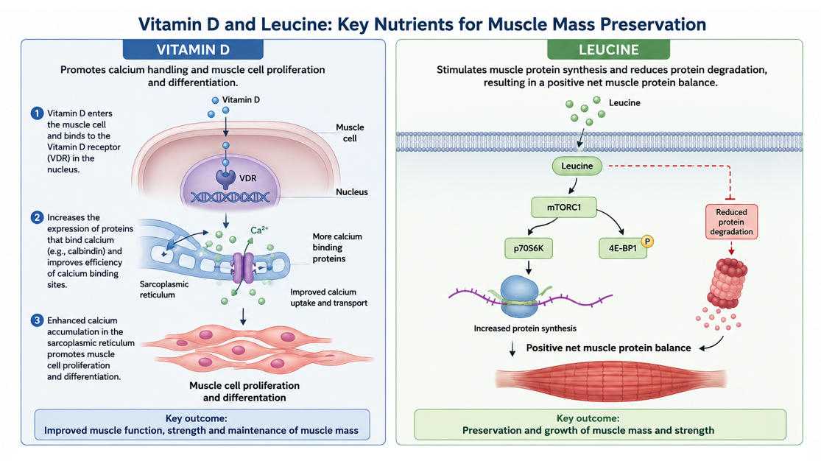

Slide 14
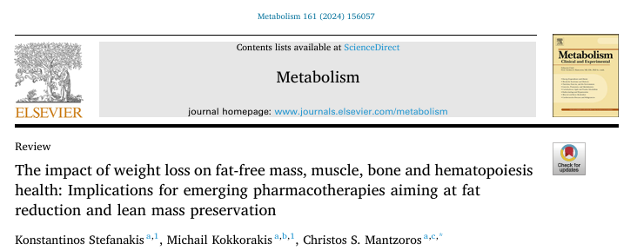


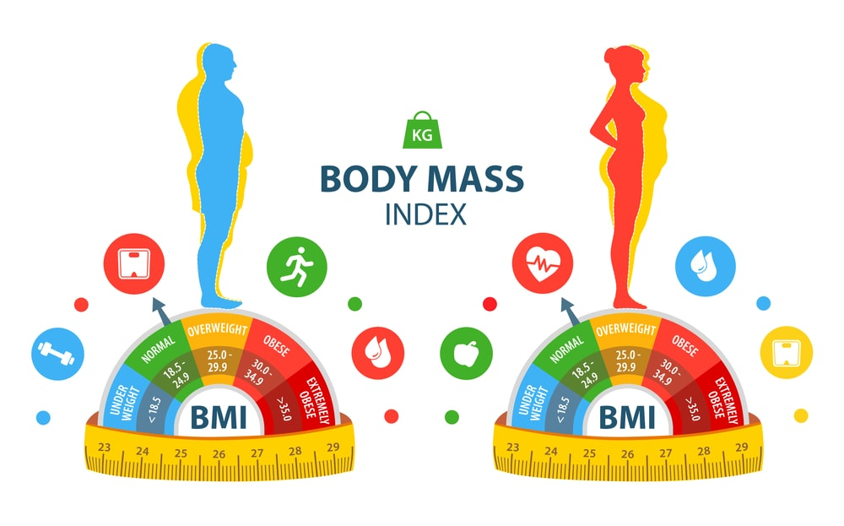
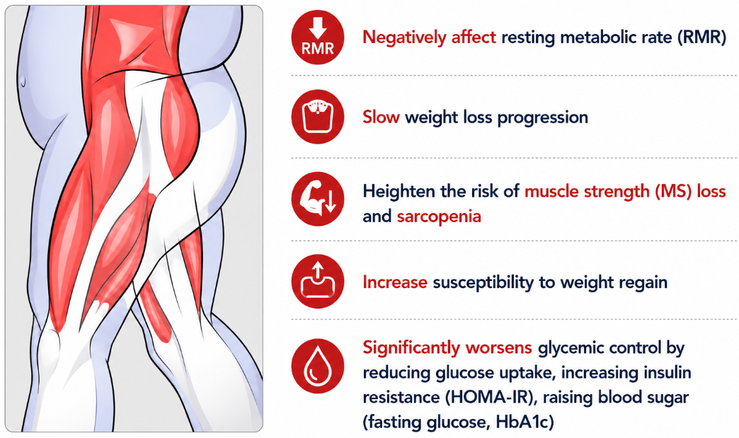
WEIGHT LOSS QUALITY: MAIN OBJECTIVE
Metabolism 161 (2024) 156057
PRESERVE FAT-FREE MASS
BODY WEIGHT

Slide 15
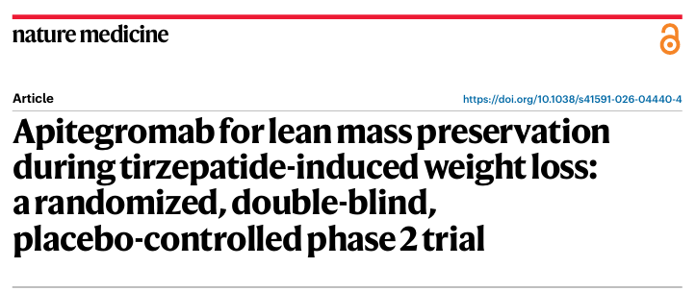
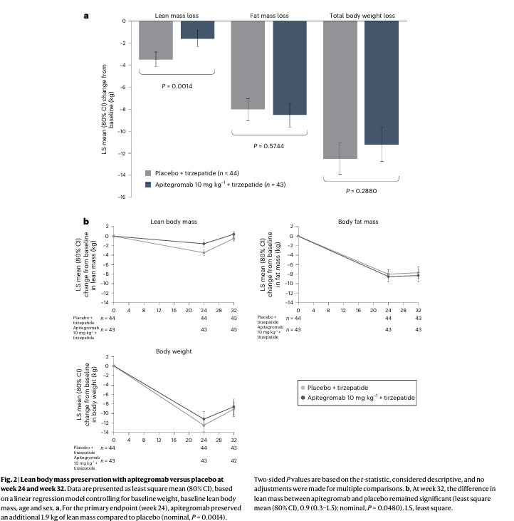
Volume 32 | July 2026 | 2673–2678
Apitegromab is an investigational, fully human monoclonal antibody that selectively inhibits myostatin activation and is, thereby, capable of increasing muscle mass
At week 24, apitegromab resulted in a least square mean (80% confidence interval (CI)) of 1.9 (1.2−2.7) kg less lean mass loss than placebo (P = 0.001), despite similar total body weight loss between groups, representing a 54.9% retention of lean mass relative to placebo

Slide 16
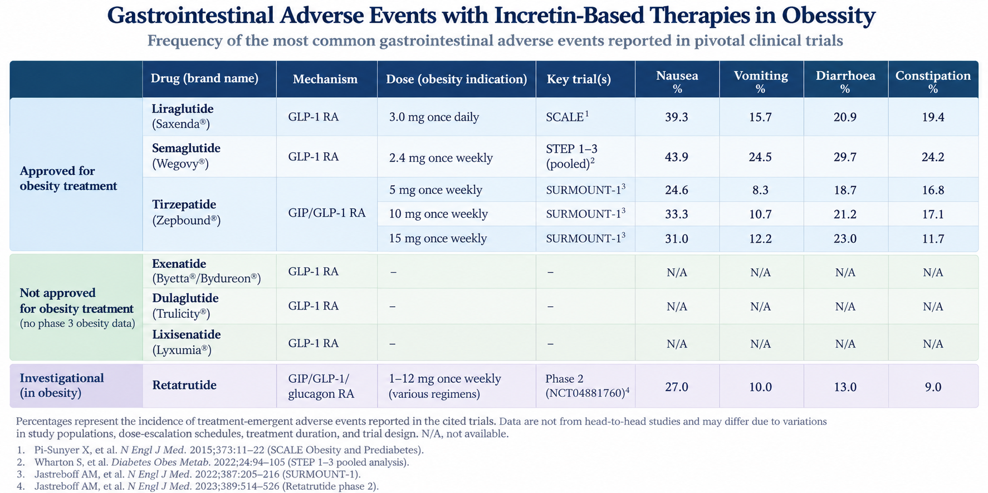

Slide 17
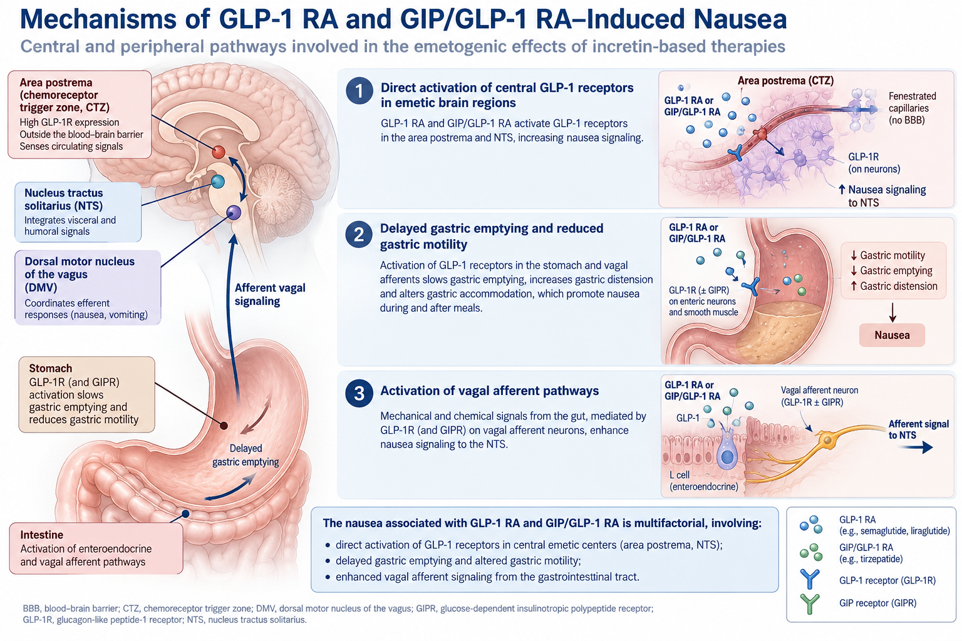

Slide 18
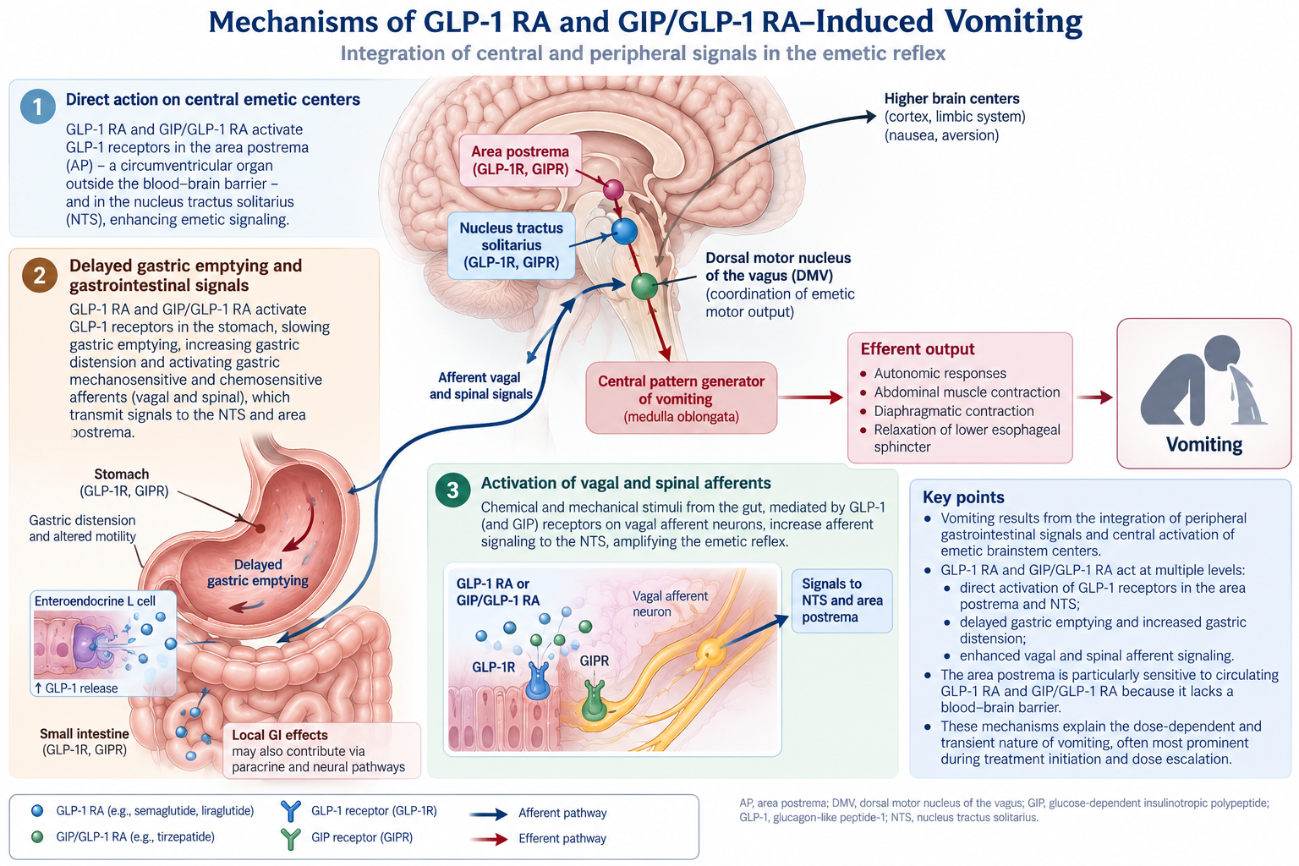

Slide 19
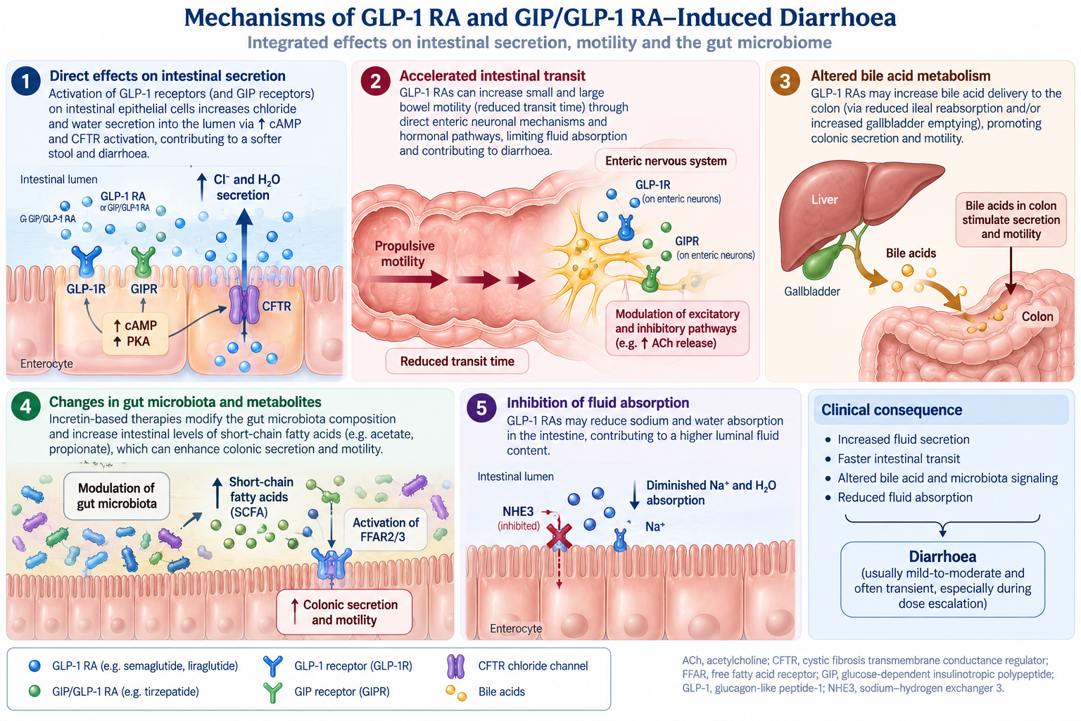

Slide 20
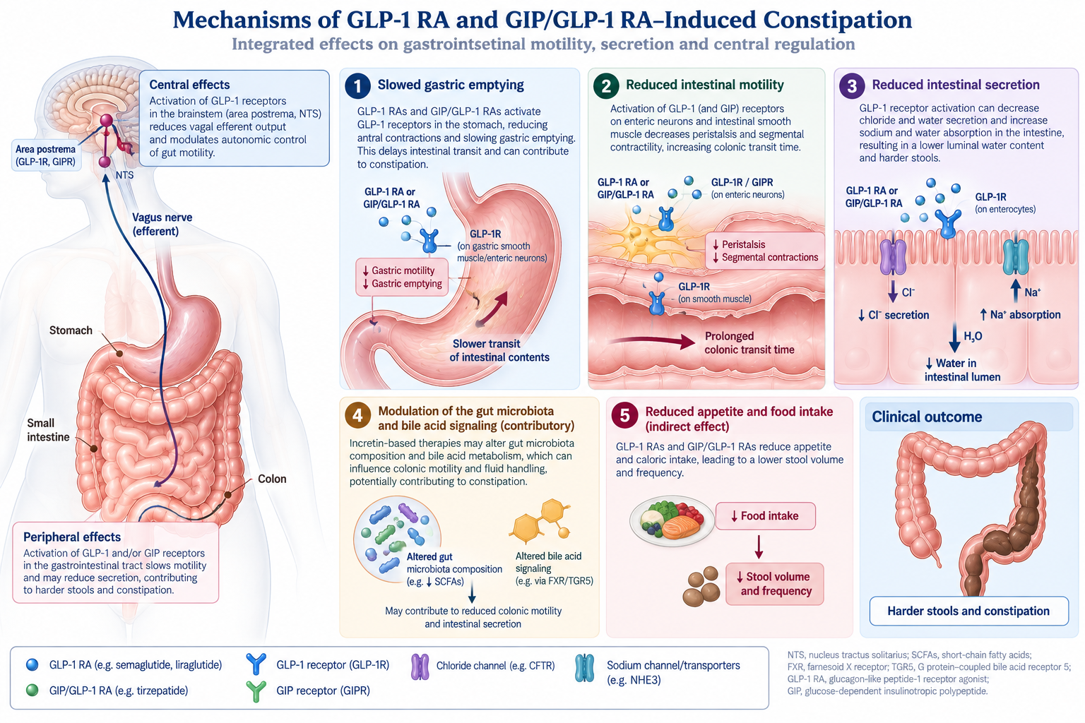

Slide 21
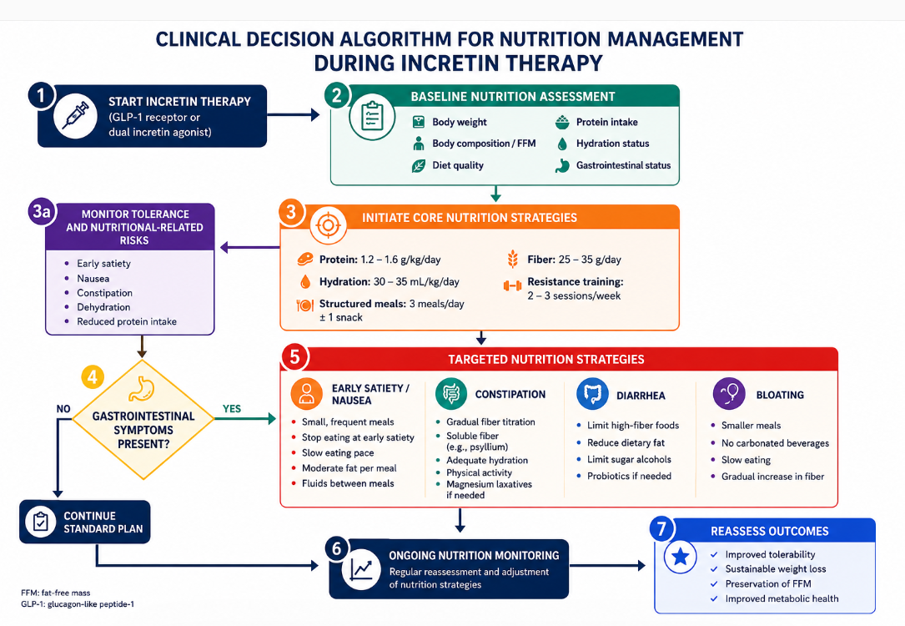
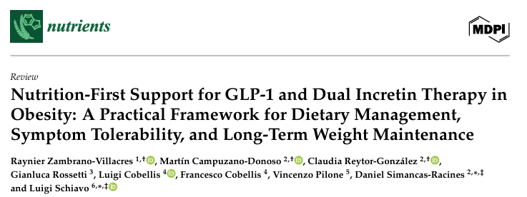
2026, May 29;18(11):1751

Slide 22
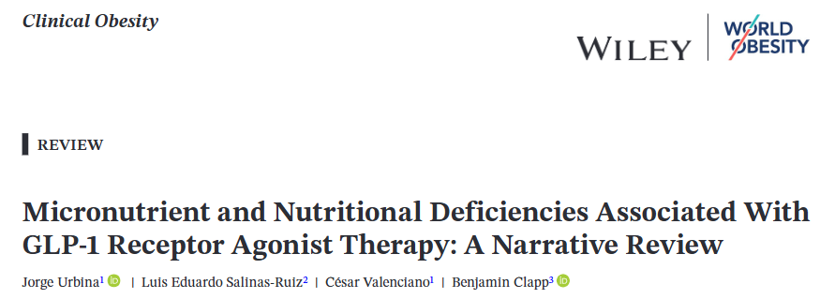
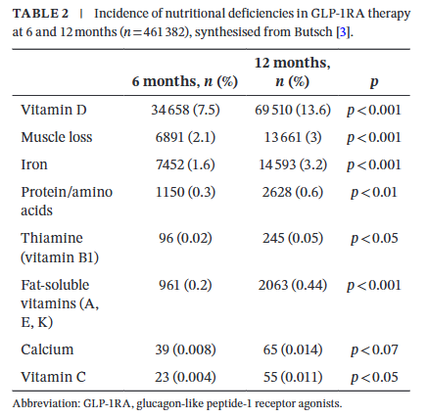
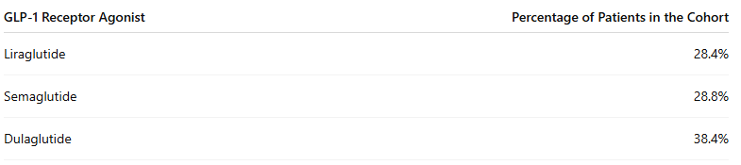
2026; 16:e70070
Table: Distribution of GLP-1 Receptor

Slide 23
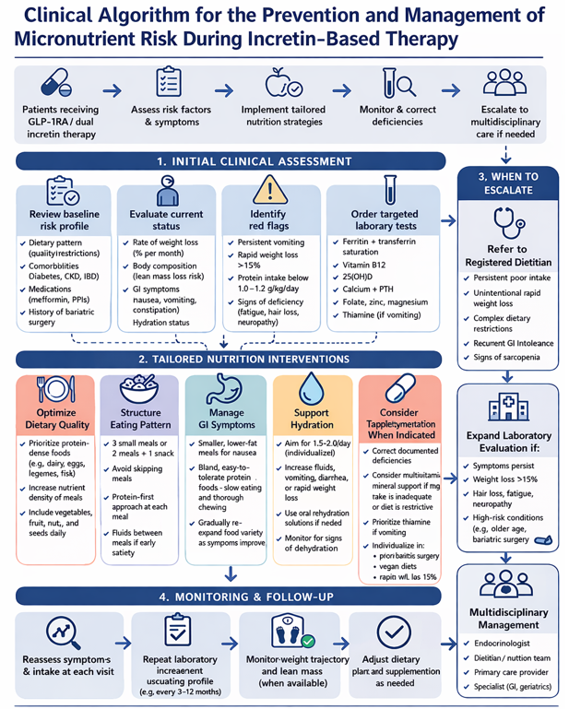
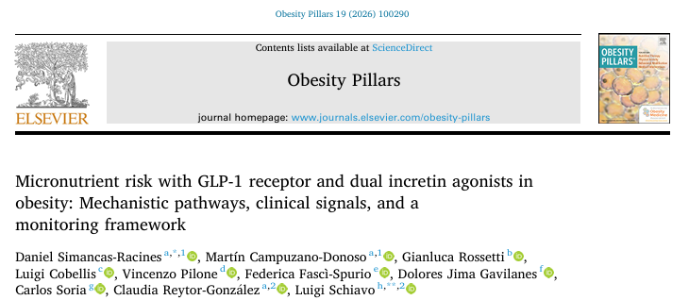

Slide 24
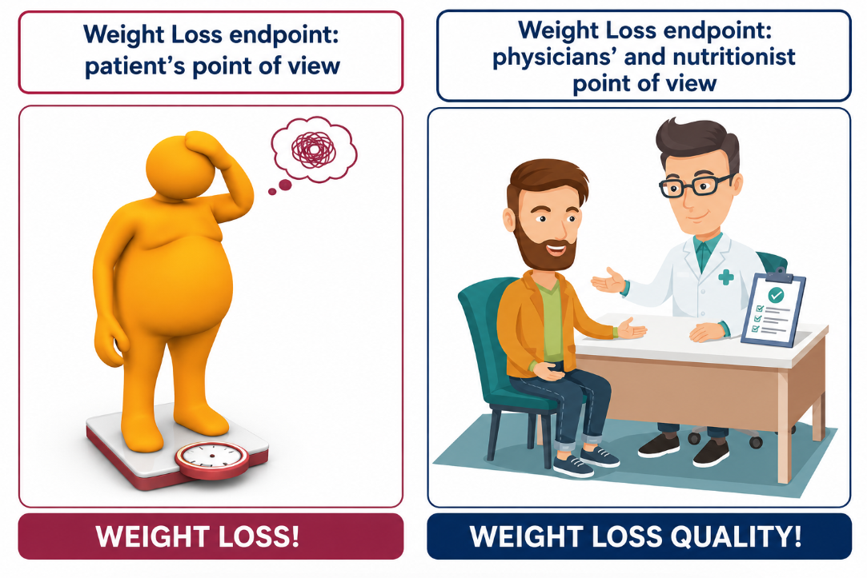
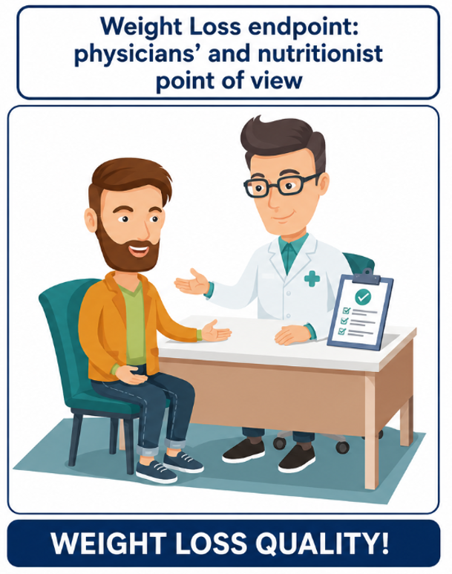

Slide 25
TAKE HOME MESSAGE
Even during GLP-1 RA treatment, nutrition must remain a pillar in obesity management
GRAZIE
lschiavo@unisa.it

